Slide 1

AGENDA 2030 AND PREVENTION/EMERGENCY MANAGEMENT:
NEED OF «NEW APPROACHES» TO INCREASE TERRITORIAL RESILIENCE
Eng. Nicola BERNI
(Umbria Region)
B-READI PILOT
University of L'Aquila - from 26 to 30 June 2023

Slide 2



Ideas that inspired the thesis work for the Master 21-22 in O.P.E.M.
1
Every territory should deal with its future of development and well-being addressing risk prevention and the citizens safety as priorities
2
In modern society, crisis management requires an "integrated" and "multidisciplinary" approach
3
Italian civil protection, with its undisputed ability to manage emergencies, must further develop risk forecasting and prevention
4
Unfortunately, these activities are not a “political priority”: integration of all the synergies, policies and funding available today is needed
Master II level O.P.E.M. - Official of Prevention and Emergency Management

Slide 3
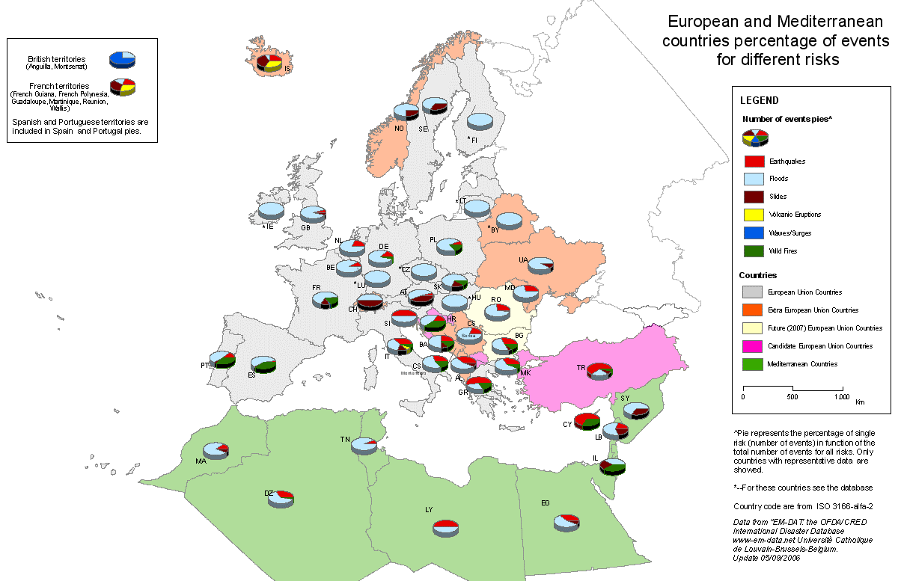
CIVIL PROTECTION RISKS: EUROPE
RISK = HAZARD x EXPOSURE x VULNERABILITY
E = earthquake; T = Tsunami; F = Fires; L = Landslides; V = Volcanic; FL = Floods
(OFDA/CRED International Disaster Database)

Slide 4
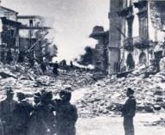
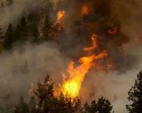
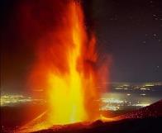
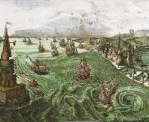
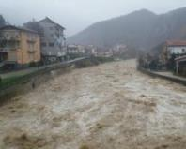

ITALY: A COUNTRY PRONE TO DISASTERS
Earthquakes
All the Italian territory is highly prone to seismic risk
Forest Fires
30% of the Italian territory is exposed to forest fires risk
Volcanoes
10 volcanos, 2 active and 8 quiescent (Vesuvio and Campi Flegrei at very high risk)
Tsunamies
Italy has been affected by historical tsunamies
Floods/Landslides risks
91% of Italian municipalities are exposed to these risks
Drought
Due to climate change the drought risk has increased

Slide 5
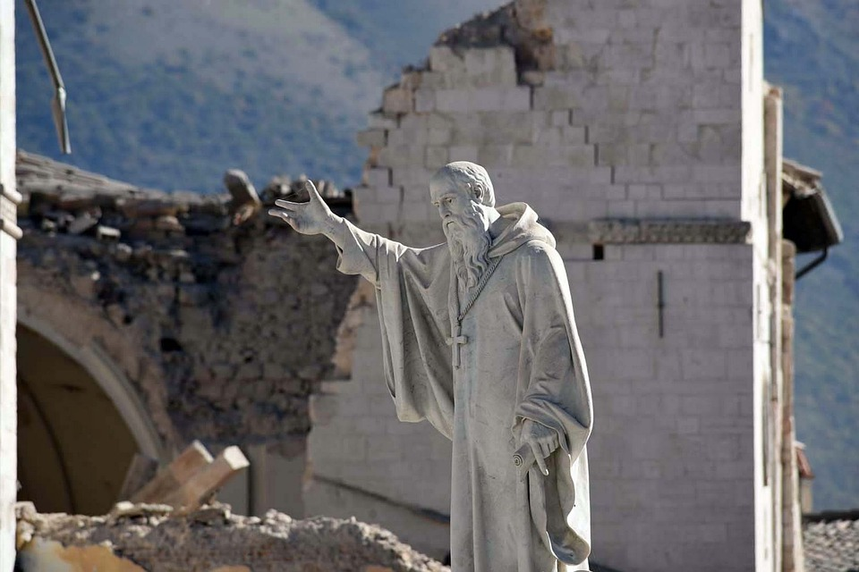
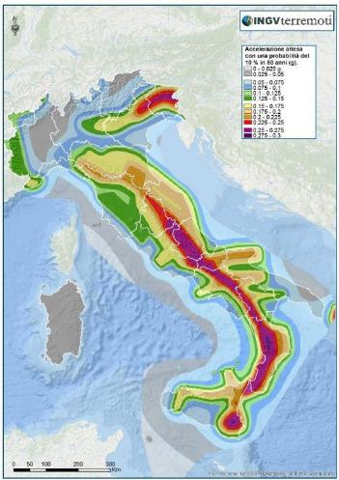
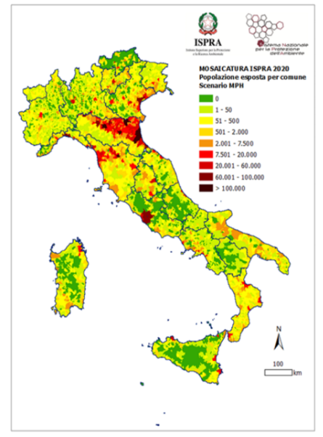
ITALY: A COUNTRY PRONE TO DISASTERS
All Italian municipalities classified as risk prone areas for earthquakes: 34% of them at very high or high risk!
70% of seismic activity along Appennine mountains.
Over 30% of population live in high risk areas!
High values of exposure and vulnerability (e.g. cultural heritage during Central Italy 2016-2017 earthquakes)
91 % of Italian municipalities have floods and/or landslides prone areas (almost 20% of national territory at risk).
Regions with higher number of municipalities at risk (9 with 100%): Valle D'Aosta, Liguria, Emilia- Romagna, Toscana, Umbria, Marche, Molise, Basilicata e Calabria.
For effective risk area (5): Valle d’Aosta ed Emilia-Romagna with approx 60%, Toscana, Campania and Provincia Autonoma di Trento with approx 30%.
Population living in risk areas: over 18% in Liguria, Emilia-Romagna and Toscana). Residential buildings at risk 14%, commercial/industrial activities 16%, Cultural Heritage over 25% (Toscana and Emilia-Romagna mainly)
Seismic risk
Floods and landslides risk

Slide 6
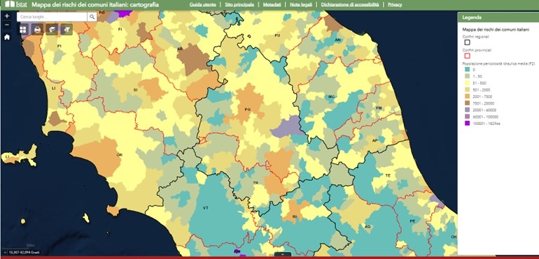
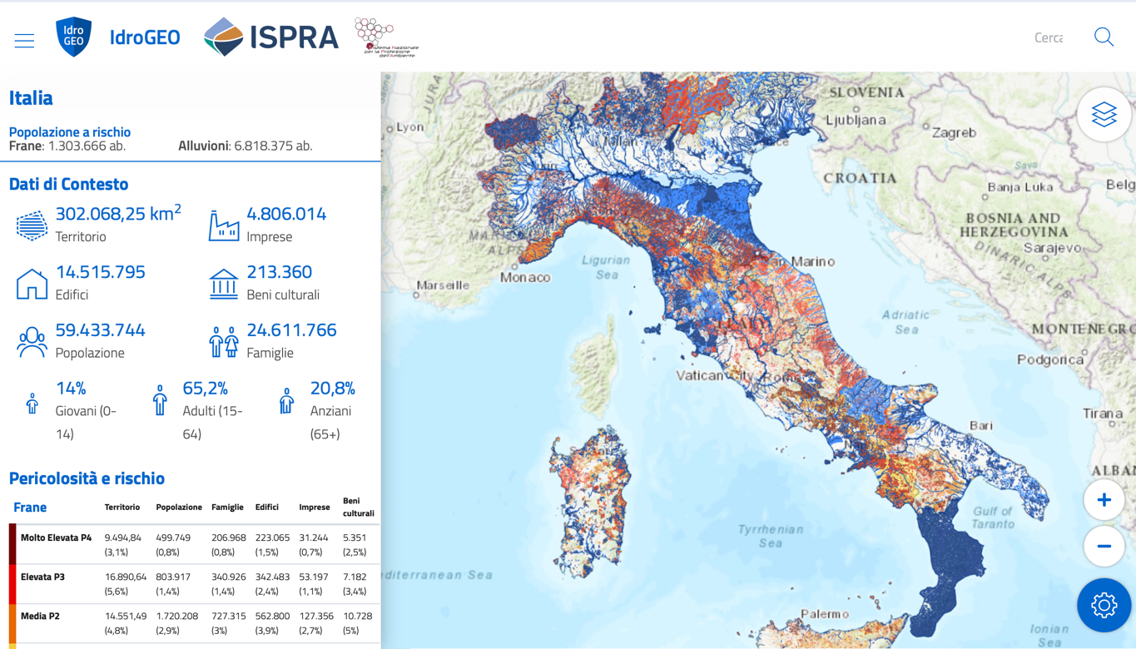
ITALY: A COUNTRY PRONE TO DISASTERS
National and regional statistics and GIS data/platforms for hazard and risk scenarios

Slide 7
CIVIL PROTECTION IN ITALY: MANDATE
“
2018
1992
1982
Establishment of
the Department of Civil Protection
Leg.D.l. 02.01.2018
Italian Civil Protection Code
Law 225
Establishment of the National Civil Protection Service
To safeguard human life and health, goods, the national heritage, human settlements, animals and the environment from both natural or man-made disasters”
“
From 1992 to 2018 the civil protection System has evolved through other regulatory measures

Slide 8
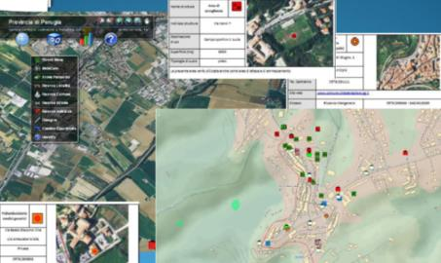
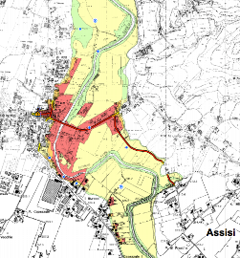
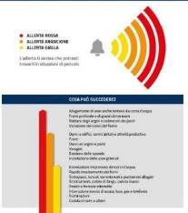
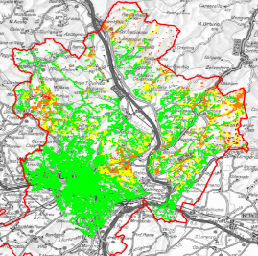





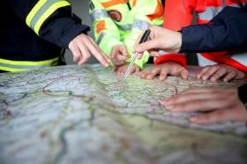
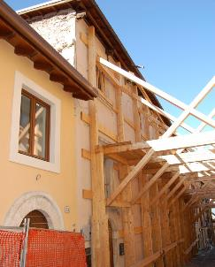
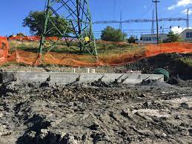

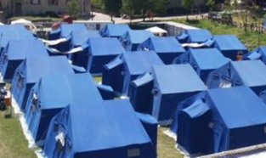
CIVIL PROTECTION IN ITALY: ACTIVITIES
PREDICTION/FORECAST
PREVENTION (structural and non structural) AND PREPAREDNESS
Risk scenarios identification and study
Risk reduction
RECOVERY
EMERGENCY MANAGEMENT
Resumption of a normal living conditions
Relief and assistance

Slide 9
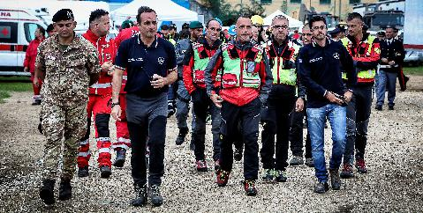

CIVIL PROTECTION IN ITALY: MAIN PLAYERS
The Italian Department of civil protection coordinates the National Service of Civil Protection which involves several Private and Public Bodies/ Organisations :
PUBLIC (Government, Ministries, Regions, Provinces, Municipalities, Emergency Services & other “Operational Bodies” etc.)
SCIENTIFIC/ACADEMIC (Universities, Research Institutes, etc.)
CIVIL SOCIETY (Volunteers, private companies, professional associations, etc.)
Civil protection in Italy can be equated to a FUNCTION
within a COMPLEX and COMPREHENSIVE SYSTEM
and NOT TO A TASK assigned
to a single administration

Slide 10
CIVIL PROTECTION IN ITALY: EMERGENCIES and AUTHORITIES
The National Service of Civil Protection distinguishes events (either natural or man made) based on impact they have:
Upper level act if local authorities cannot provide with their means and resources (vertical subsidiarity).
A – local level
EMERGENCIES
B – provincial and regional level;
C – national and international level.
A and B events can be managed through ordinary relief operations
C events must be managed making recourse to extraordinary means and powers.
THE PRESIDENT OF THE COUNCIL OF MINISTERS NAMELY THE PRIME MINISTER
The Department of Civil Protection coordinate the National Service of Civil Protection to ensure the unified representation envisaged by the European Union and international bodies operating in the field of civil protection; the Prefectures – Local Government Offices.
AUTHORITIES
REGIONAL GOVERNORS/PRESIDENTS OF REGIONS AND AUTONOMOUS PROVINCES
TOWN MAYORS AND CITY MAYORS

Slide 11
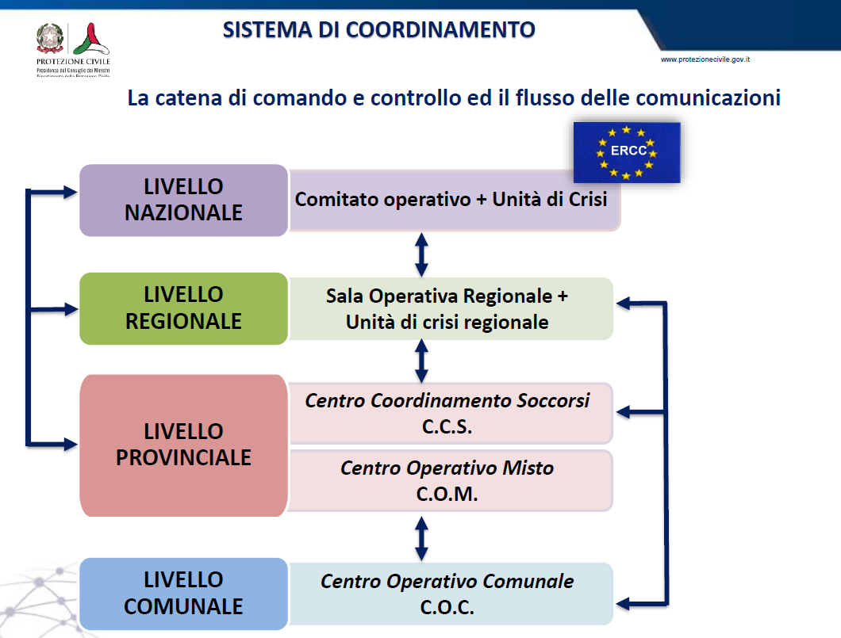
CIVIL PROTECTION EMERGENCY MANAGEMENT
(“bottom – up” approach)

Slide 12
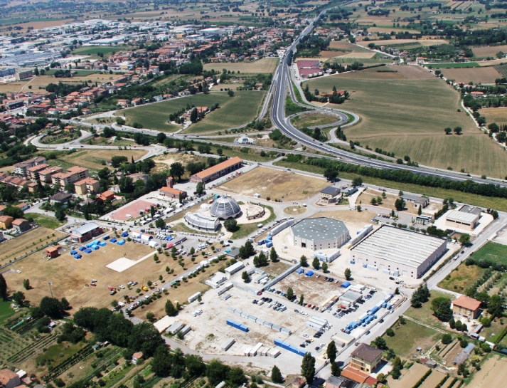


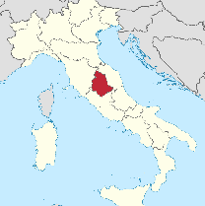
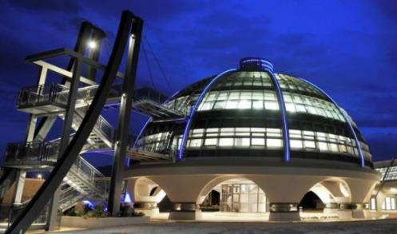
Umbria Region
(central Italy)
Civil Protection Centre
Foligno (PG)

Slide 13
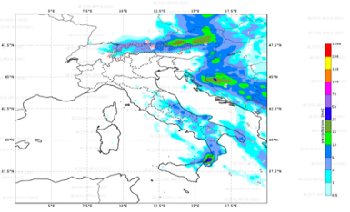
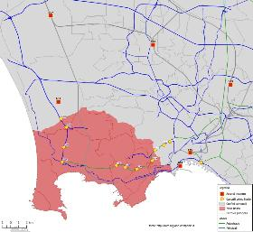
CIVIL PROTECTION “MAIN CHALLENGE”: PREVENTION
NON STRUCTURAL
STRUCTURAL
Early warning/Alerting
Dissemination of civil protection culture , information to the population and communication in case of emergency
Self-protection and behaviour code norms
Civil protection planning and linking activities with local civil protections
Training
Exercises
Application of technical legislation
Participation in the definition of policies dealing with structural prevention of risks
Participation in the planning of mitigation operations
Implementation of structural mitigation operations in case of disaster /crisis events
Activities integrated with structural and non structural prevention activities

Slide 14

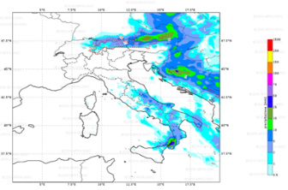
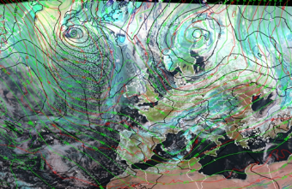
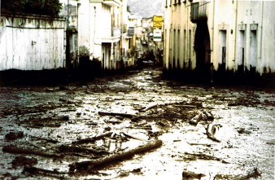
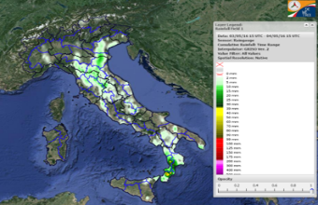
EARLY WARNING/ALERTING ITALIAN NETWORK
(«Centri Funzionali» and «Centri di Competenza»)
WEATHER/METEO
FORECASTING
GROUND EFFECTS EVALUATION
Forecasting, monitoring and supervision of risk scenarios
Declaration of expected critical levels → early warning
Civil Protection planning at regional-local levels operational activation
MONITORING
(DURING EVENTS)
24h monitoring and decision support for C.P. authorities

Slide 15
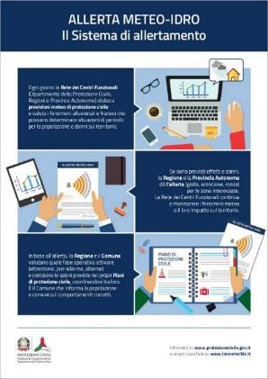
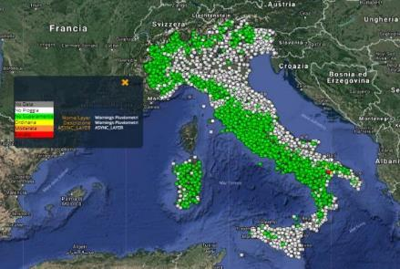
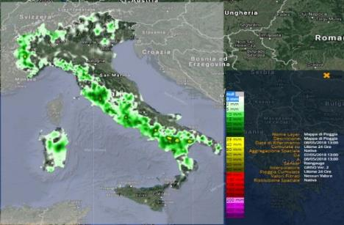
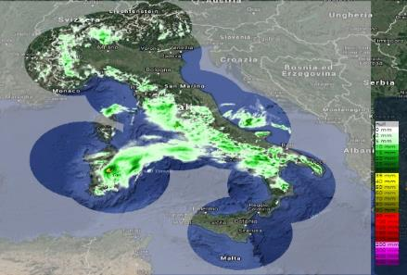
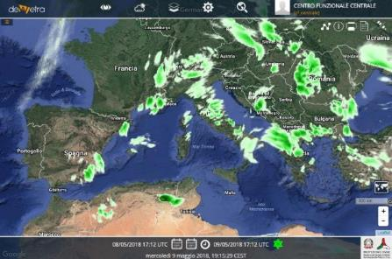
EARLY WARNING/ALERTING ITALIAN NETWORK
(«Centri Funzionali» and «Centri di Competenza»)
Rete pluviometrica fiduciaria
Mappa di precipitazione
«Dewetra» web platform
Rete radar nazionale
PR OBS 5 – H05 (HSAF)

Slide 16
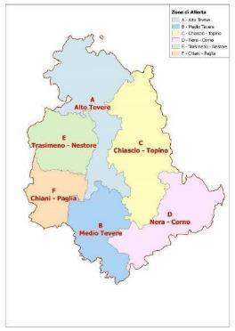
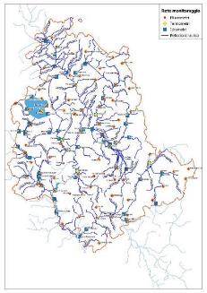
Umbria Region early warning procedures
DDGR 2312 e 2313/2007 → «NEW» DGR n. 1055/2021
www.cfumbria.it

Slide 17
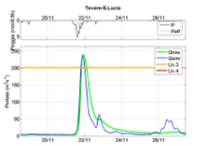
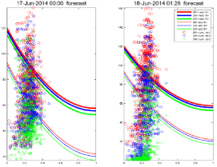
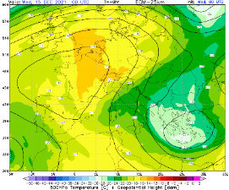
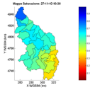
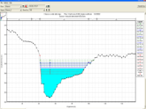
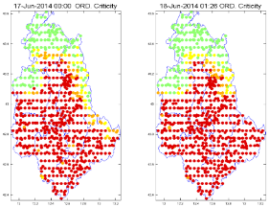
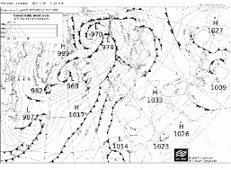
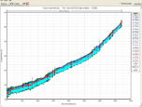
Umbria Region early warning tools
Hydrologic/hydraulic models
Landslides triggering with statistical models
Meteorological models
ECMWF, COSMO5M, MOLOCH, WRF
TOPKAPI, MISDc, STAFOM, HEC-RAS, FLOODPROOFS
PRESSCA, LANDWARN
Notes:
17

Slide 18
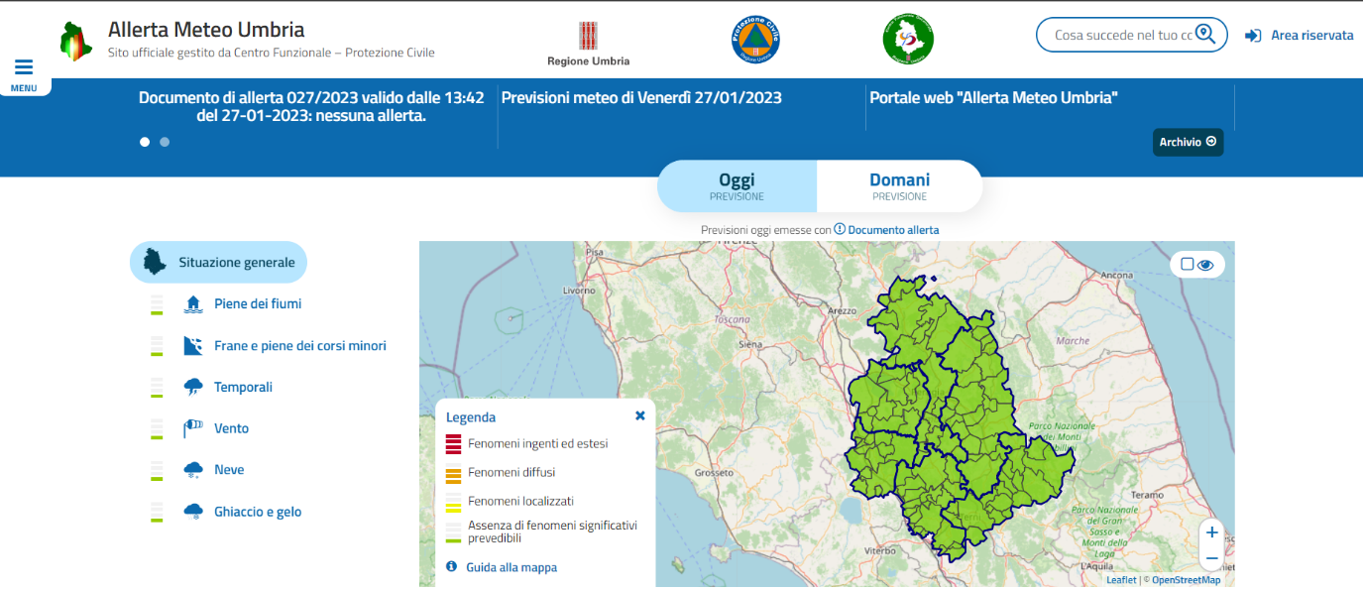
Umbria Region early warning DSS
Since 2007

Slide 19

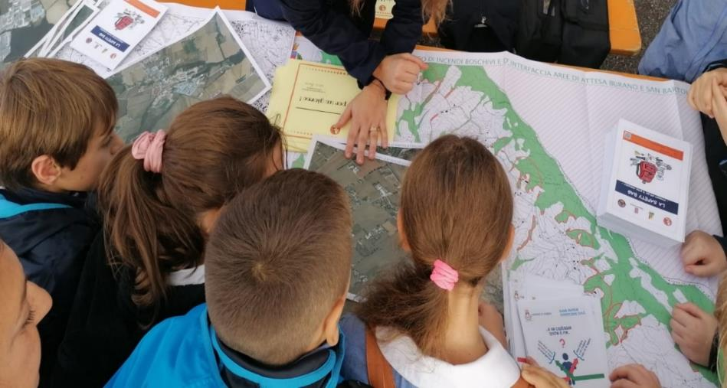
Civil Protection Planning in Italy
National C.P. planning
Regional/Provincial C.P. planning
Municipal level C.P. planning
“integrated strategic planning” approach required!
coordination among plans and citizen participation are key!
Civil protection plan assimilates the forecasting and prevention plan and is the instrument which allows the authorities to prepare and coordinate the relief interventions to protect the population and the heritage in a risk area. It has the objective of guaranteeing life at “civil” levels by any means possible. A plan must be sufficiently flexible to be used in all the emergencies, including unexpected ones, and simple enough to be implemented rapidly.
Notes:
RUOLO DELLA REGIONE NELLA PIANIFICAZIONE DI PC – Si tratta di un ruolo che si pone nell’ambito della responsabilità amministrativo-gestionale tenuta distinta-nel codice- dalla responsabilità politica.
La Regione svolge attività di previsione e prevenzione che necessariamente si legano alla gestione e al superamento dell’emergenza, perciò il suo ruolo principale è quello di individuare le priorità di previsione e prevenzione in funzione degli eventi che si possono verificare e alla peculiarità del territorio per programmare gli interventi e pianificare la gestione dell’emergenza.
In riferimento alla pianificazione, la Regione ha prima di tutto l’importante compito di disciplinare l’organizzazione del SRPC, attraverso una legge regionale ad hoc. In relazione all’esercizio delle funzioni di pc a livello territoriale, ad esempio, la Regione deve individuare l’organizzazione territoriale organizzativa ottimale ed omogenea per area geografica per lo svolgimento in forma associata da parte dei Comuni delle attività di pianificazione di pc e di coordinamento dei primi soccorsi. In questo poi il ruolo delle Province risulta essere un tassello che manca e su cui la Regione deve riflettere. Pertanto l’ambito ottimale deve tenere conto di come si possa sopperire al vuoto gestionale costituito dall’»assenza» delle Province , ma soprattutto di come questo vuoto possa essere colmato considerando che le funzioni relative alla raccolta ed elaborazioni dati, ad esempio, sono ancora di competenza provinciale e che la Regione, inserendole nel vasto ambito della previsione e prevenzione, può attribuire nuovamente alle Province (in virtù dell’art. 11, co. 1, lett. o).
Tutto ciò porta l’urgente necessità di realizzare la Legge regionale in materia.
Per informazioni Silvia Olivieri (solivieri@regione.umbria.it)

Slide 20
Risk Perception: Umbria Regione example, 2013
Umbria Region civil protection «multirisk» study, 2013
(DOXA, thanks to POR-FESR 2007-2013 EU funds):
Talks and interviews for homogeneous focus groups among local administrators, civil protection technicians and volunteers, citizens of various ages and cultural backgrounds.
Qualitative (psycholinguistic modules) approach in a specific but significant regional area.
Themes:
Perception of the risks looming over the territory of residence and concerns about their effects;
Perception of the role and functions of civil and citizen protection;
Perception of the role of civil protection volunteers;
Perception of the proximity of the local, regional and national civil protection system;
Perception of the Municipal Civil Protection Plan and what to do before, during and after a flood, earthquake, forest fires, etc;
Perception of the critical points and strengths of the system, priority of structural and non-structural interventions to mitigate the effects of risks for the future.

Slide 21
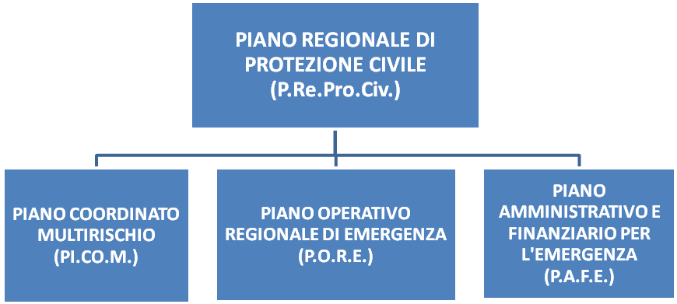
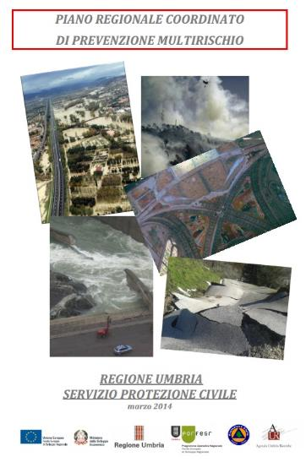
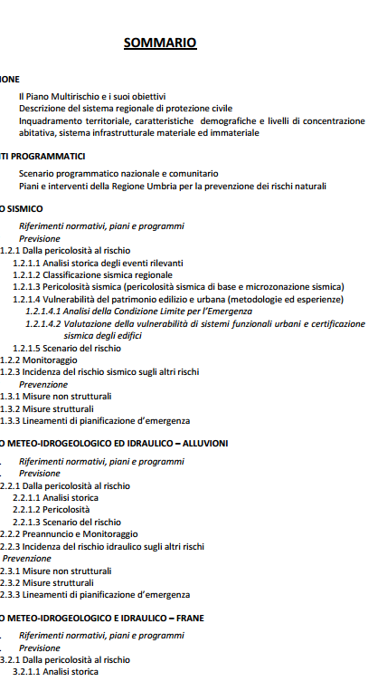



Umbria Region C.P. plan
D.G.R. 376 del 07/04/2014
Approved with D.G.R. n.376/2014
Notes:
Fonte normativa e descrizione sintetica di come è strutturato il piano Regionale di protezione civile della Regione Umbria; PI.CO.M. approvato con DGR 376 del 07/04/2014, il resto in corso di redazione.
(Per il P.A.F.E. non è ancora iniziato lo studio)

Slide 22




Umbria Region C.P. plan

Slide 23



Umbria Region C.P. plan
(update in progress after Covid-19)
2020: Covid-19 emergency

Slide 24





Regional Guidelines for Municipal C.P. plans
Redatte con Anci Umbria Prociv. Conclusa fase partecipativa, adottate con DGR n. 859/2018
+ ALLEGATI:
Schede autovalutazione Piano Comunale (Fondazione CIMA);
Cartellonistica aree

Slide 25


AGENDA2030: new way to “read” territory and current/next challenges
The SDGs, build on decades of work by countries and the UN, represent an “urgent call for action” by all countries - developed and developing - in a global partnership. They recognize that ending poverty and other deprivations must go hand-in-hand with strategies that improve health and education, reduce inequality, and spur economic growth – all while tackling climate change and working to preserve our oceans and forests (civil protection purposes included!).

Slide 26

AGENDA2030: new way to “read” territory and current/next challenges
UMBRIA REGION (ITALY) example of monitoring
(source ASVIS national report)

Slide 27

Civil Protection Planning: new tools required
Territorial Resilience Indicators:
the approach to European funds must be "performance based": the MCDA approach has been tested in the Province of Terni – UMBRIA REGION
(“Multi Criteria Decision Analysis”)
AHP type (“Analytics Hierarchy Process”)

Slide 28

Civil Protection «local governance»: new tools required
The Italian territory is characterized by a polycentric and interdependent system, with towns, rural areas and smaller clusters linked by a solid network of relations, and larger towns and cities, which attract people because of their wealth of public services. Access to services such as education, mobility and healthcare is crucial.
The more remote rural areas, historically deprived of many of these services, have gone through a lengthy and steady period of abandonment in favor of urban areas, which has taken a heavy toll in terms of hydro-geological instability, decay and soil consumption. The fall in population has been matched by a decline in essential services.
These areas, however, contain much untapped regional, natural and human capital, seen as strategic for the recovery and growth of Italy’s entire system. Intervention targeted at safeguarding, rehabilitating and revitalizing inner territorial areas has been deemed necessary, in order to overcome the urban/rural dichotomy and put a new perspective on the concept of service acceptability.
These ‘Inner Areas’ are defined as areas being at some considerable distance from centers offering such services, and where there has been a fall in population and a rise in degradation. Demographic trends, access to healthcare and adequate education provision are just some of the essential criteria for defining and classifying Inner Areas.

Slide 29

Civil Protection «local governance»: new tools required
These areas cover approximately 59% of the Italian territory and are home to around 23% of national population. Italian national strategy is aimed to reversing the depopulation and marginalization of these areas, hinging on two key economic policy assets: improving personal services and triggering local development projects.
In this context, since 2018, the new Italian civil protection law has introduced a new approach to supra-municipal civil protection planning and governance: the “optimal territorial areas”, aimed to overcome the simple “emergency management” concept by enhancing “peacetime” activities and prevention and resilience aspects. The aim of the work is to seek synergies between these two different worlds, trying to provide tools to local administrations in order to face the growing challenges in terms of disaster risk reduction (also climate change related), trying to increase territorial resilience.

Slide 30


Civil Protection «local governance»: new tools required
Inner Areas Intalian Strategy 2014-2020 and 2021-2027
Territorial policy for improving the quality of services to citizens and economic opportunities in internal Italian territories at risk of marginalization (potentially affected 59% of the Italian territory and 23% of residents).
For 2014-2020 in Umbria Region, 3 areas have been activated (strategy, APQ, project implementation): For 2021-2027 other 2 areas. Budget 21-27 over 61 million euros
participated multilevel approach!
Master multidisciplinare di II Livello in O.P.E.M. - Official of Prevention and Emergency Management – A.A. 21-22

Slide 31


Civil Protection «local governance»: new tools required
Optimal civil protection Territorial Areas
“Identified by the Regions as the basic articulation of the civil protection function at a territorial level” (by recent new law for civil protection, 2018).
In Umbria, after a participatory process activated in 2019, 9 optimal areas were formally identified in 2021 (with a Primary and a Secondary Center of reference)
participated multilevel approach!
Master multidisciplinare di II Livello in O.P.E.M. - Official of Prevention and Emergency Management – A.A. 21-22

Slide 32


«Local governance»: new synergies among different policies?
If IA and OA borders are the same (eg Orvieto area, in Umbria), municipalities are accustomed to work with a supra-municipal perspective; Area strategy already defined (territorial marketing together with stakeholders); The associated function of Civil Protection is already active (budget optimization); Area Coordination Center already operational at the Primary Center of the Optimal Area coinciding with the Lead Municipality of the Internal Area; Internal Areas Office already structured.
If not (eg Valnerina area, in Umbria), some governance adjustments are required but synergy ca be still very usefull.
Master multidisciplinare di II Livello in O.P.E.M. - Official of Prevention and Emergency Management – A.A. 21-22

Slide 33

AGENDA 2030 AND PREVENTION/EMERGENCY MANAGEMENT – N.BERNI
Thank you for attention
nberni@regione.umbria.it
www.regione.umbria.it
www.regione.umbria.it/protezione-civile
B-READI PILOT
University of L'Aquila - from 26 to 30 June 2023

